Slide 1
Year 6 Transition
Class of 2025

Slide 2
Headteacher- Mrs Luhman
To have uncompromising aspirations for every individual and for the school to be an exceptional, caring and inspirational community.

Slide 3
Values
Aspiration – wanting to be the best you can be with passion, enthusiasm and commitment
Community – working together and supporting each other to ensure we can all do our best
Integrity – honestly doing the right thing even if no one ever knows.
Respect – accepting and valuing our differences with courtesy and consideration
Responsibility – doing the things you are expected to do and accept the consequences or results of your actions

Slide 4
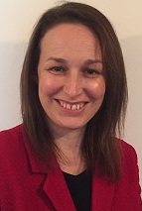
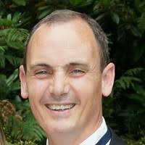
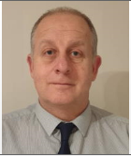
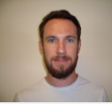
Leadership Team
Mrs Luhman- Headteacher
Mr Guyett- Deputy Headteacher
Assistant Headteachers
Mr Byrne
Mr Haywood
Mr Hurley

Slide 5
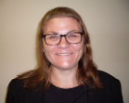
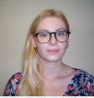
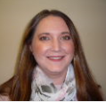
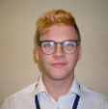
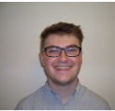
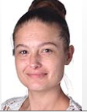
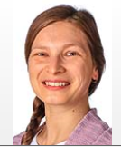
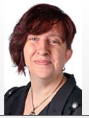
Head of Year:
Mrs Stewart
Tutors:
Mrs Chai
Miss Raymond
Mr Colgrave
Mr Baldwin
Miss Tilbury
Miss Neagu
Mrs Tigwell

Slide 6
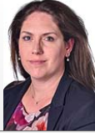
Key Stage 3 Leader: Mrs Ruck

Slide 7
House System
The Houses will be involved in:-
Academic achievements with the Heads of Faculty
Sporting events
Performing Arts
Inter house competitions

Slide 8
The Houses

Slide 9
Communication
Pastoral Concern
Form Tutor
Head of Year
Key Stage Lead
Mr Hurley (AHT)
Academic concern
Class Teacher
Head of Faculty
Key Stage Lead
Mr Byrne(AHT)
Mr Guyett- DHT

Slide 10
The Ethos
HIGH
ACHIEVEMENT
ALL ROUND
DEVELOPMENT
CARING
ETHOS

Slide 11
The Non Negotiables
Attendance
Punctuality
Uniform
Behaviour

Slide 12
Attendance
90% attendance = ½ day missed every week.
1 school year at 90% attendance = 4 whole weeks of lessons missed
Research suggests that 17 missed school days a year can equate to a GCSE grade DROP in achievement. (DfES)

Slide 13
Punctuality
Minutes lost each day = Days lost per school year
5 minutes = 3 days
10 minutes = 6.5 days
15 minutes = 10 days
20 minutes = 13 days
30 minutes = 19 days
FRIDAY SLT DETENTION- MINUTES LOST

Slide 14
Uniform
High uniform standards are indicative of the high standards that we have at our school. Our uniform is part of our school identity, uniting our students and we hope that they take pride in wearing it.
SOCIAL TIME DETENTIONS FOR LACK OF SCHOOL UNIFORM

Slide 15
Behaviour
The school may use one or more of the following sanctions in response to unacceptable behaviour:
A verbal reprimand
Sending the pupil out of the class
Expecting work to be completed at home, or at break or lunchtime
Detention at break or lunchtime, or after school
Referring the pupil to a senior member of staff
Letters or phone calls home to parents
Agreeing a behaviour contract
Putting a pupil ‘on report

Slide 16
Rewards
Student of the week (Highest number of reward points in a week – one per tutor group and postcard sent)
Star student – (nominations from each subject and house for year groups per half term - certificate)
REWARD score – (students who receive over the set benchmark of reward points – badge and certificate)

Slide 17
Safeguarding your child when using Social Media
If your child does use Social Media platforms like Instagram, Facebook or Snapchat the advice is that parents should monitor who their child is ‘friends’ with and be aware of the passwords to all Social Media apps.
Any form of abusive language or derogatory comments should be reported to the specific Social Media platform.
You can also report the abuse using CEOP (Child Exploitation Online Protection) at www.ceop.police.uk
Change the security settings and re-set password regularly – or better still, delete the app completely!
Talk to your son/daughter about staying safe online – DO NOT GIVE ANY PERSONAL INFORMATION OUT e.g. ADDRESS, SCHOOL, DATE OF BIRTH.
Discuss with your child what is appropriate to put onto Social Media – if they wouldn’t want you to see it, its not alright!
If you are concerned about your child talking to strangers online alert the police immediately by calling 101.
Students receive training and advice on a range of issues related to Social Media such as staying safe online, what not to do online, sexting and exploitation throughout their time at Kings.

Slide 18
Mobile phones should be switched off and stored away before morning registration
Parents/carers are requested that in cases of emergency they contact the college reception so we are aware of any potential issue and may make the necessary arrangements
While on college premises mobile phones are not to be used by students.

Slide 19
Monitor homework from home

Slide 20
New Catering Contract
Nut Allergy
Airborne nut allergy
No products containing nuts

Slide 21
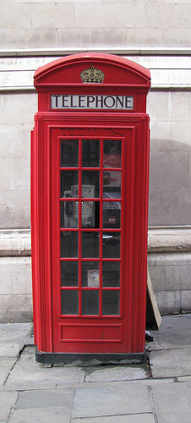
Keeping in Contact
Communication via:
Tutor
Head of Year
Head Of Departments
Head of KS3

Slide 22
Opening school in September
Inside the parent portal there is a powerpoint from Mrs Luhman that has been shared with students in Year 8 to 11. The powerpoint covers what school will look like in September, Year 6 students may wish to view this information.

