Slide 1
Y11 Independent Study

Slide 2
Purpose:
Provide TIME
Provide RESOURCES
Provide TEACHER SUPPORT
for students to improve their attainment outcomes at GCSE level

Slide 3
Why?
Because the ONLY person who can ensure YOU achieve the best possible results is YOU.

Slide 4
How do I take ownership?
Be HONEST with yourself.
Don’t make excuses, find SOLUTIONS.
GO TO “Year 11 Study Skills 2020-21” in Teams
USE the information in the “Personal Effectiveness” channel

Slide 5
How can I identify my knowledge & skills “gaps”?
Go to “Year 11 Study Skills 2020-21” in Teams
Select “Know Your Knowledge Gaps” channel
Click on “Files” at the top of the page.
Select the subject you want to work on.
Use the Learning Checklists

Slide 6
How do I “work smart”?
Spend time working on what you DON’T know or AREN’T good at.
Use revision guides
Use GCSE Bitesize
Use the learning apps for your subject eg Hegarty, Tassomai, Kerboodle
Use past exam papers
ASK for help if unsure

Slide 7
How do I submit my independent work?
Post it in a class Team and ask your teacher to offer feedback
Email it to your teacher and ask for feedback
Hand a hard copy to your teacher and ask for feedback
However you submit, just making your teacher aware you are working to improve will likely get an enthusiastic response to help you along JUST DO IT!

Slide 8
How can I improve my outcomes?
Take OWNERSHIP. No excuses.
Use your TIME productively. Remove distractions.
Identify your GAPS.
Work SMART. Work on weakness, not on strengths.
SUBMIT your work, accept experts tips to improve.

Slide 9
So how do I start?
Don’t worry, JUST START.
Remember “Done is better than perfect”
Remember “Little and OFTEN”
Small steps to big SUCCESS

Slide 10
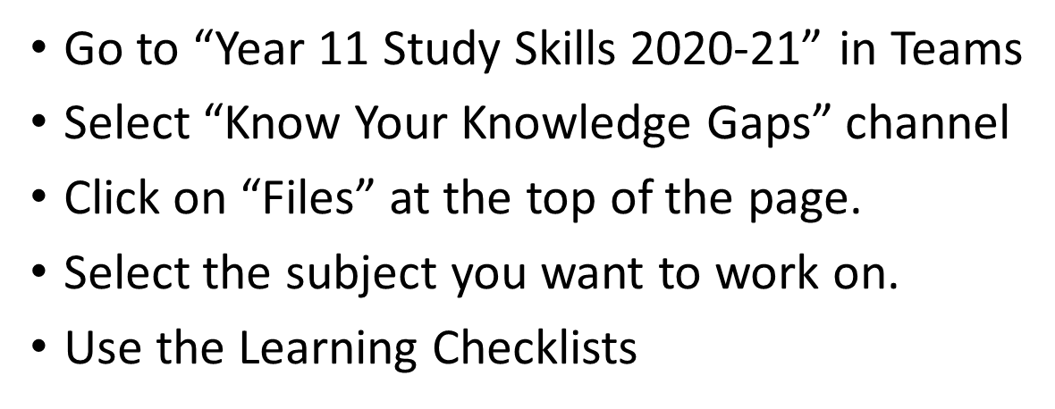
Don’t wait… START NOW!

