Slide 1
Return to school plans

Slide 2
Tutor groups.
5 lessons a day covering all the subjects.
Still have different teachers for your subjects
Moving around the school to your classrooms
Able to use the café
Able to take part in practical subjects
Rewards system
Can still borrow books from the library.
What will be the same?

Slide 3
What will be different ?
Tutor time is at the start of the day.
One-way systems into certain buildings.
Will not be able to use lockers initially.
Breaks and lunchtimes are at different times.
No sharing of equipment like pens and pencils.
Year 11 Common room.
New outdoor eating area.
Wearing PE kit on days that you have Dance or PE
End of the day is slightly different for different year groups

Slide 4
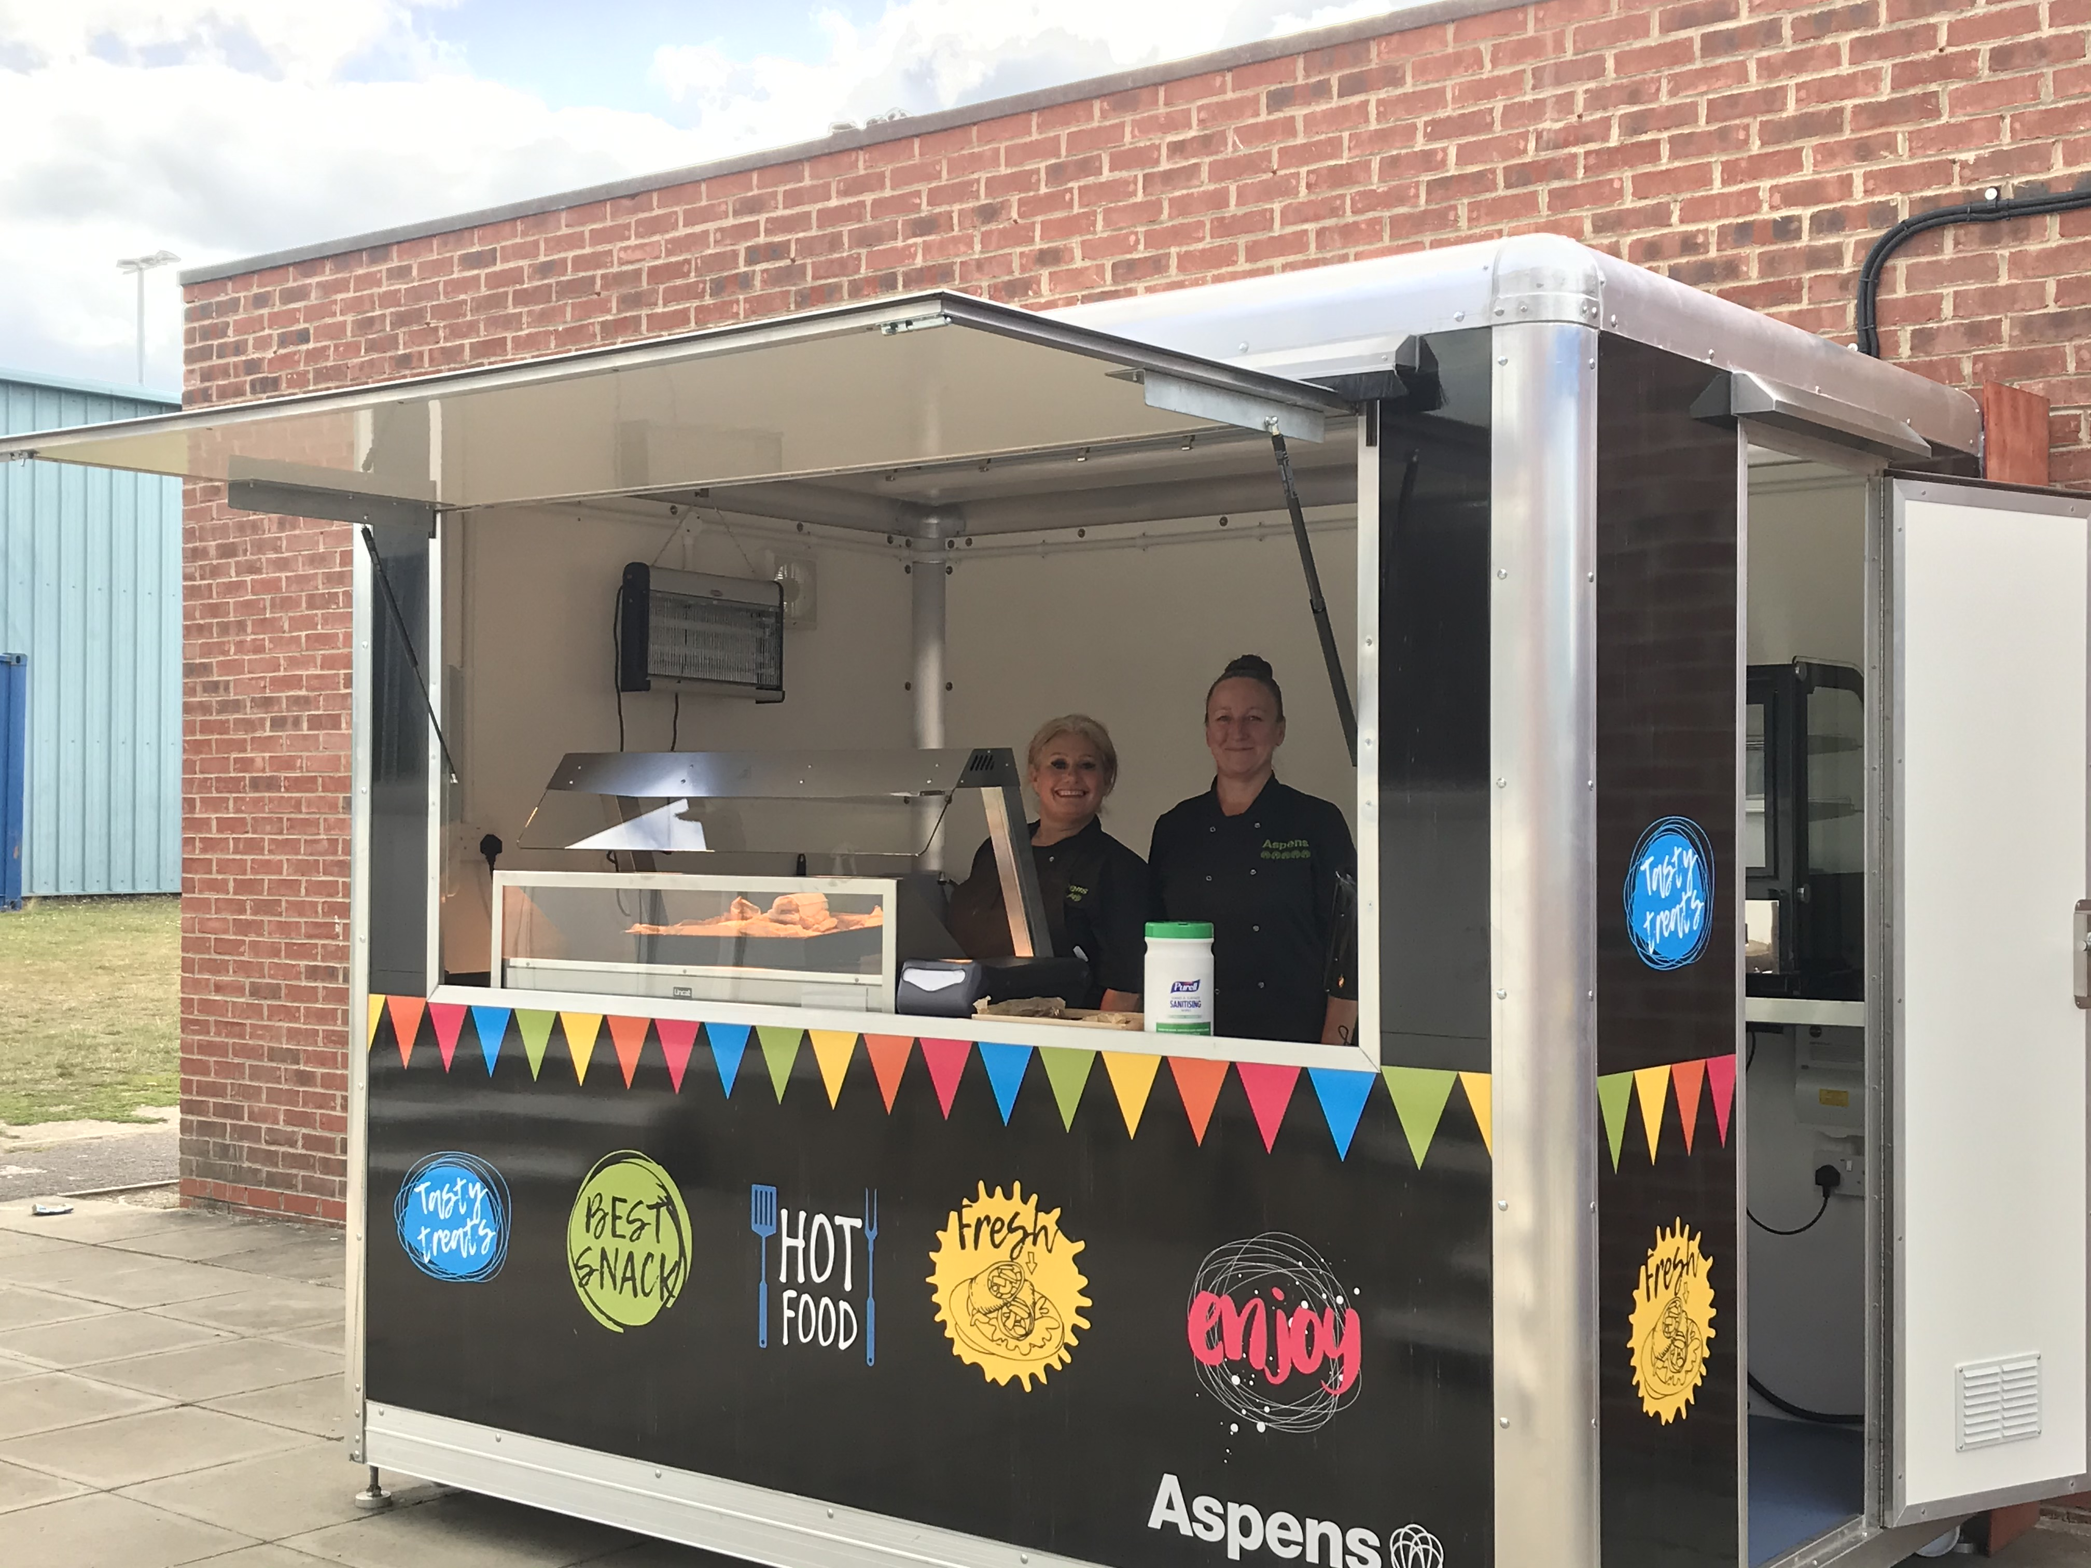
What will be different ?

Slide 5
Year bubbles
Year 7 bubbles of 30 will be taught in tutor groups apart from Tech.
Year 8 bubbles of 90 and 60 will be taught in two half year bubbles.
Year 9 bubble of 138 students due to options.
Year 10 bubble of 130.
Year 11 bubble of 150.

Slide 6
 | 8.20 – 9.00 | 9.00 – 10.00 | 10.00 – 10.30 | 10.30 – 11.00 | 11.00 – 11.30 | 11.30 – 12.30 | 12.30 – 1.00 | 1.00 – 1.30 | 1.30 – 2.00 | 2.00 – 3.00*
7 | Tutor | P1 | Break | P2 |  | P3 | Lunch | P4 |  | P5
8 | Tutor | P1 | Break | P2 |  | P3 | Lunch | P4 |  | P5
9 | Tutor | P1 | P2 |  | Break | P3 | P4 |  | Lunch | P5
10 | Tutor | P1 | P2 |  | Break | P3 | P4 |  | Lunch | P5
11 | Tutor | P1 | P2 |  | Break | P3 | P4 |  | Lunch | P5
Tutor time - From 8.20am Registration at 8.40am
End of Day - Year 7 leave at 2.55pm, Yr. 8 and 9 at 3.05pm and Yr. 10 and 11 at 3.15pm

Slide 8
Keeping you safe
Outdoor handwashing stations around the school
All the classrooms will have surfaces cleaned after every lesson.
One-way systems will reduce crowded corridors.
Designated zones for each year group at break and lunch.
Social distancing between staff and pupils.
Cleaning of all specialist equipment in practical subjects between lessons.

Slide 9
What will we expect of you?
We need you to firstly have a restful Summer.
Follow our behaviour rules which will now include following health and safety directions.
Make sure that any hair colouring or extra piercings are removed by September the 3rd.
Ask us for support if you are struggling
Stay alert by ensuring you wash your hands regular.
Follow the " Catch it, Bin it, Kill it" for coughs and sneezes.
Wear masks on public or school transport.

Slide 10
Start of term
3 Sep.
Year 7, 8 and 9 in school
( Year 10 and 11 remote learning)
4 Sep.
Year 7, 10 and 11 in school
(Year 8 and 9 remote learning)
Mon. 7
All year groups will be in.

Slide 11
In other news
New music room
New textiles room
New IT room
Wifi for the whole school site
Delayed but happening this year…
New Science lab
New food tech room
Toilets being refurbished outside Drama

